Slide 1

Linear Algebra
Naeem Ul Islam
Contact: naeem@saturn.yzu.edu.tw
  Office: 70928

Slide 2
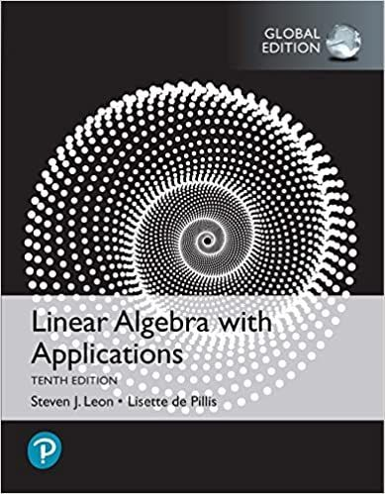
Linear Algebra
Linear Algebra with applications
By
Steven J. Leon
Introduction: 1-<number>

Slide 3
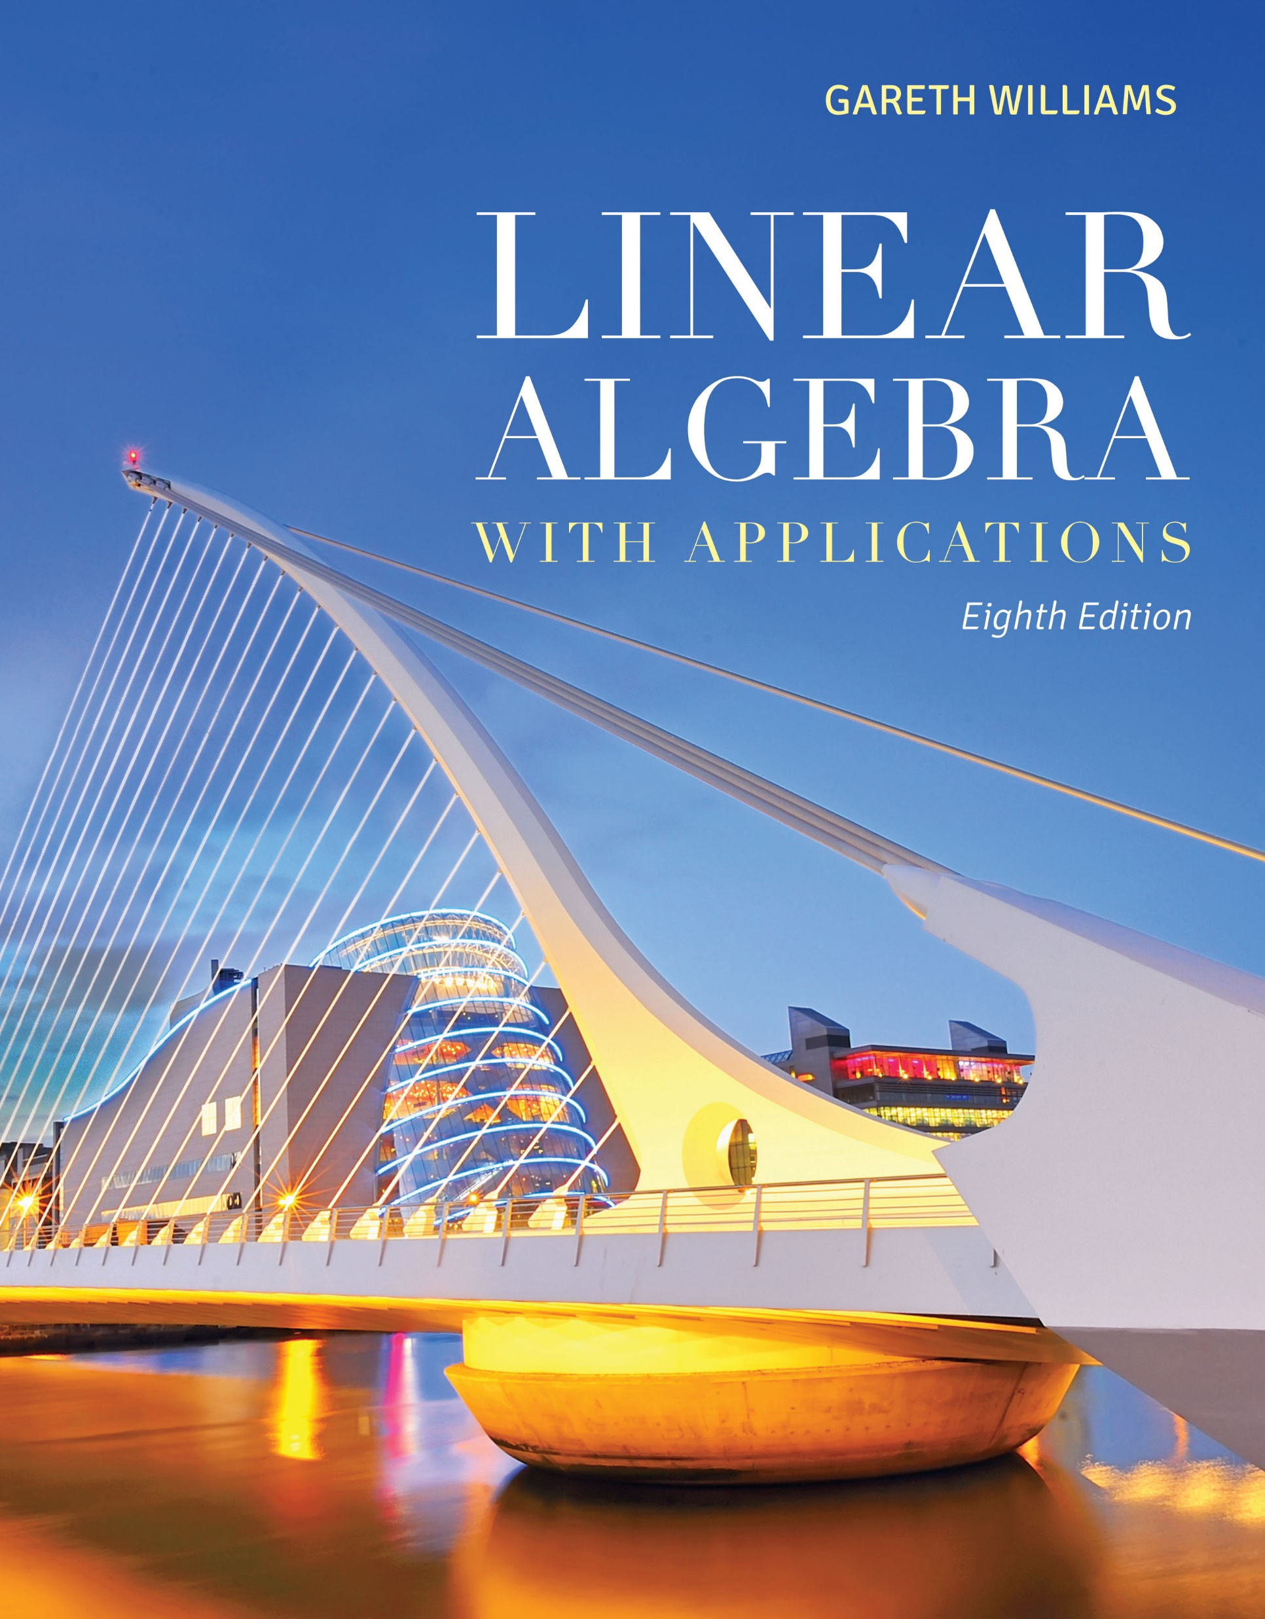
Linear Algebra
Linear Algebra with applications
By
Gareth Williams
Introduction: 1-<number>

Slide 4

Linear Algebra
Grading
Quizzes 15%
Assignments 10%
Class activities 20%
Mid Term 25%
Final Term 30%
Introduction: 1-<number>

Slide 5

Linear Algebra
Chapter 1 Linear Equations and Vectors:
  Solving systems of two linear equations to solving general systems.
  The Gauss-Jordan method of forward elimination is used
  Concepts of linear independence, basis, and dimension are discussed.
Introduction: 1-<number>

Slide 6
Linear Algebra
Chapter 2 Matrices and Linear Transformations:
  matrix multiplication, transpose, and symmetric matrices
  Solutions to a homogeneous system of linear equations forms a subspace
  Applications
Introduction: 1-<number>

Slide 7
Linear Algebra
Chapter 3 Determinants and Eigenvectors:
  Determinants and Eigenvectors
  Applications weather prediction
Introduction: 1-<number>

Slide 8
Linear Algebra
Chapter 4 General Vector Spaces:
  Concepts of subspace, linear dependence, basis, and dimension are defined rigorously and are extended to spaces of matrices and functions
  Linear transformations, kernel, and range are used to give the reader a geometrical picture of the sets of solutions to systems of linear equations, both homogeneous and nonhomogeneous
Introduction: 1-<number>

Slide 9
Linear Algebra
Chapter 5 Coordinate Representations:
  Coordinate Representations of vectors and matrices
Introduction: 1-<number>

Slide 10
Linear Algebra
Chapter 6 Inner Product Spaces :
  The axioms of inner products are presented and inner products are to define norms of vectors, angles between vectors, and distances in general vector spaces.
Introduction: 1-<number>

Slide 11
Linear Algebra
Chapter 7 Numerical Methods:
  Solving linear systems of equations using Gaussian elimination, LU decomposition, and the Jacobi and Gauss-Seidel iterative methods.
Introduction: 1-<number>

Slide 12
Linear Algebra
Chapter 8 Linear Programming:
Introduction: 1-<number>

Slide 13
Chapter 1
Systems of Linear Equations
Linear Algebra

Slide 14
1.1 Matrices and Systems of Linear Equations
Definition
An equation in the variables x and y that can be written in the form ax + by = c, where a, b, and c are real constants (a and b not both zero), is called a linear equation.
Ch1_<number>
Ch1_<number>

Slide 15
1.1 Matrices and Systems of Linear Equations
Definition
An equation such as x+3y=9 is called a linear equation
(in two variables or unknowns).
The graph of this equation is a straight line in the xy-plane.
A pair of values of x and y that satisfy the equation is called a solution.
Ch1_<number>
Ch1_<number>

Slide 16
Definition
A linear equation in n variables x₁, x₂, x₃, …, x_{n} has the form a₁ x₁ + a₂ x₂ + a₃ x₃ + … + a_{n} x_{n} = b
where the coefficients a₁, a₂, a₃, …, a_{n} and b are real numbers.
Ch1_<number>
Ch1_<number>

Slide 17
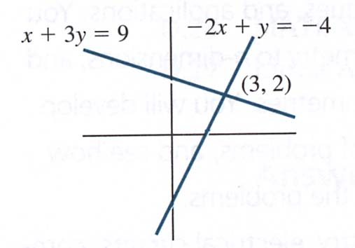
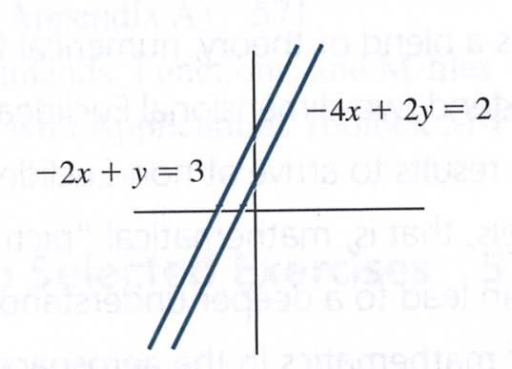
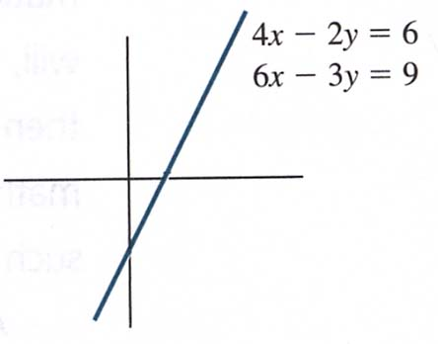
Solutions for system of linear equations
Figure 1.3
Many solution
4x – 2y = 6
6x – 3y = 9
Both equations have the same graph. Any point on the graph is a solution. Many solutions.
Figure 1.1
Unique solution
x + 3y = 9
–2x + y = –4
Lines intersect at (3, 2)
Unique solution:
x = 3, y = 2.
Figure 1.2
No solution
–2x + y = 3
–4x + 2y = 2
Lines are parallel.
No point of intersection. No solutions.
Ch1_<number>
Ch1_<number>

Slide 18
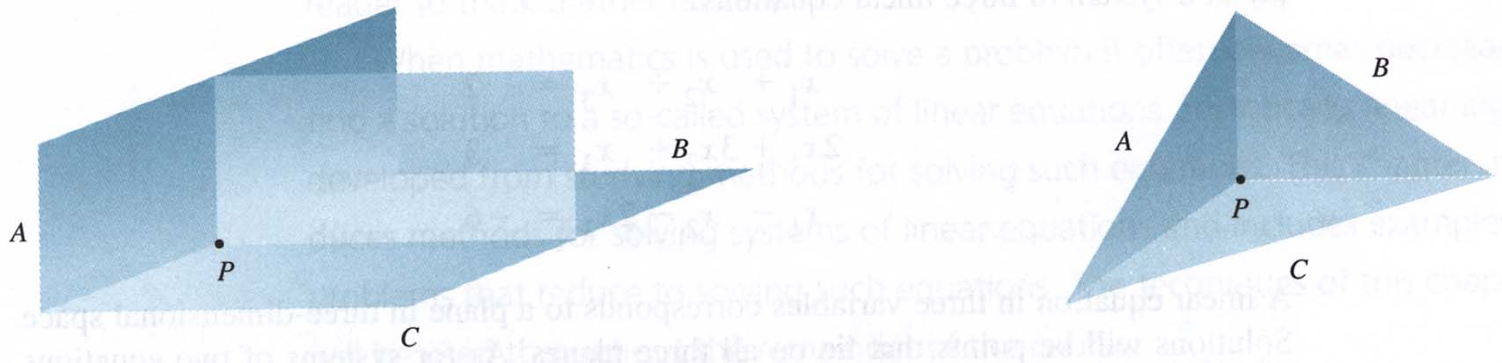
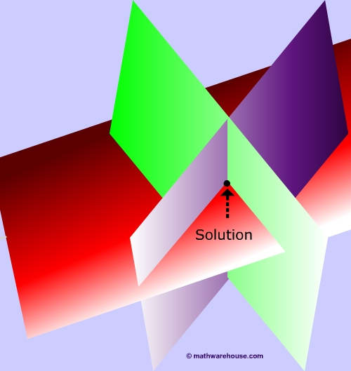
A linear equation in three variables corresponds to
a plane in three-dimensional space.
※ Systems of three linear equations in three variables:
Unique solution
Ch1_<number>
Ch1_<number>

Slide 19
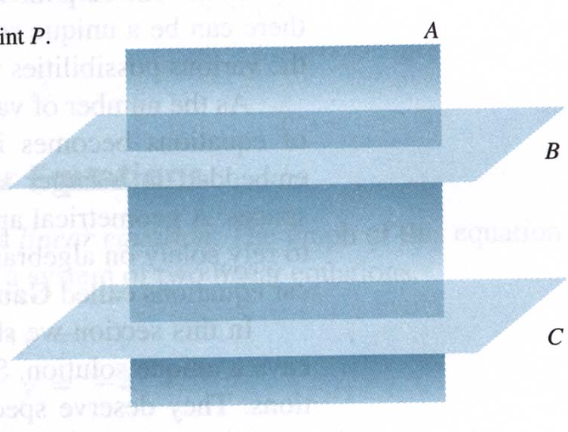
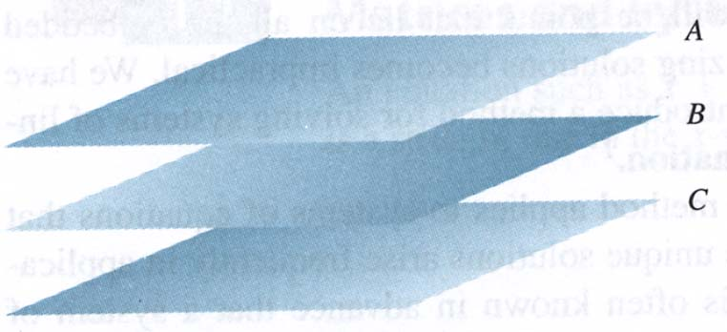
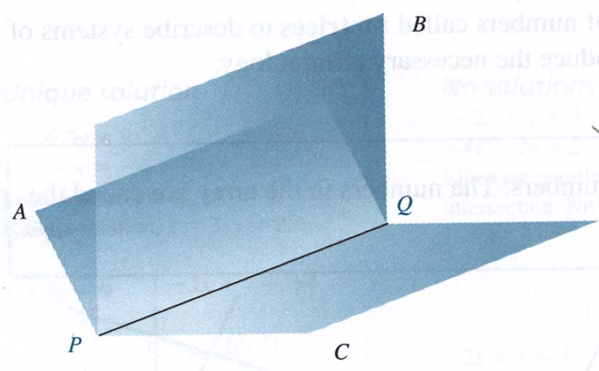

No solutions
Many solutions
Ch1_<number>
Ch1_<number>

Slide 20
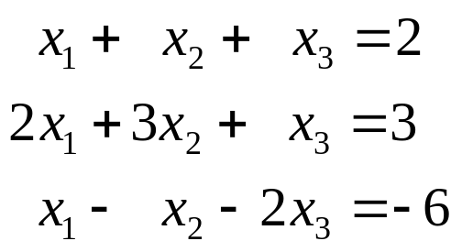
A solution to a system of a three linear equations will be points that lie on all three planes.
The following is an example of a system of three linear equations:
How to solve a system of linear equations? For this we introduce a method called Gauss-Jordan elimination. (Section1.2)
Ch1_<number>
Ch1_<number>

Slide 21
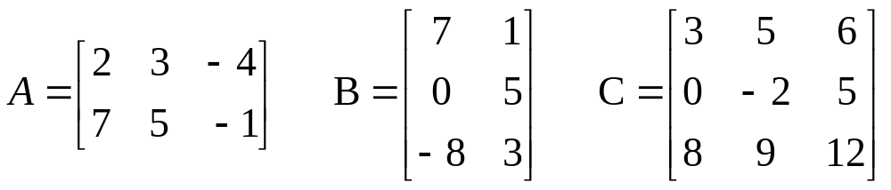
Definition
A matrix is a rectangular array of numbers.
The numbers in the array are called the elements of the matrix.
Matrices
Ch1_<number>
Ch1_<number>

Slide 22
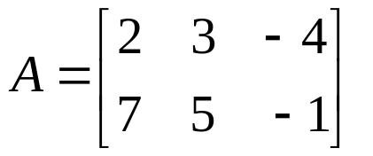
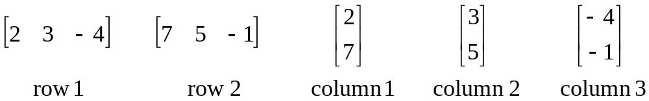
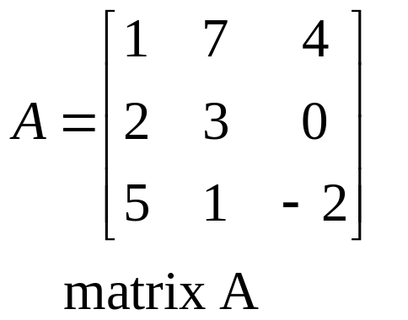
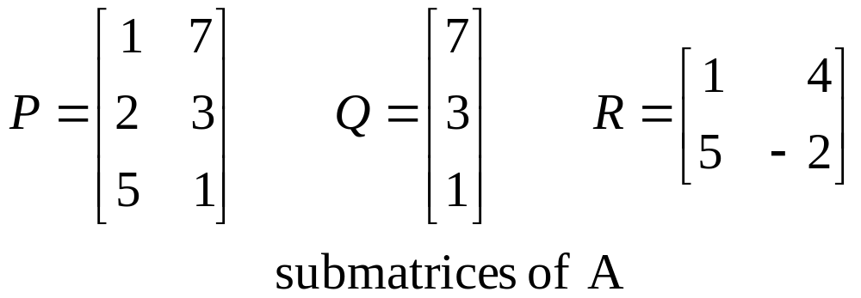
Row and Column
Submatrix
Ch1_<number>
Ch1_<number>

Slide 23
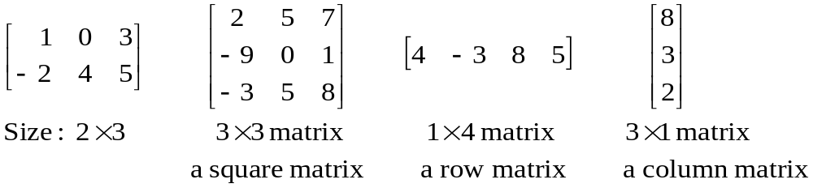
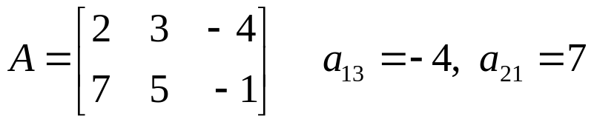
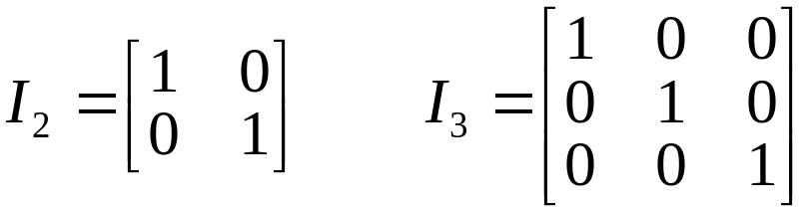
Size and Type
Location
The element a_{ij} is in row i , column j
The element in location (1,3) is −4
Identity Matrices
diagonal size
Ch1_<number>
Ch1_<number>

Slide 24
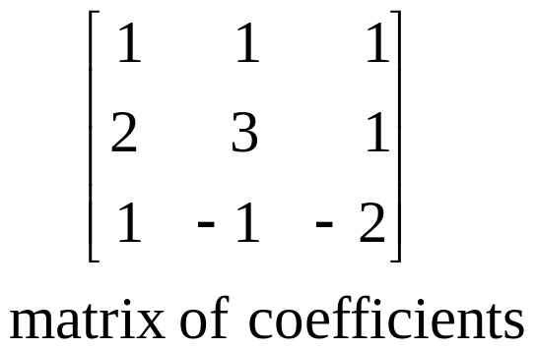
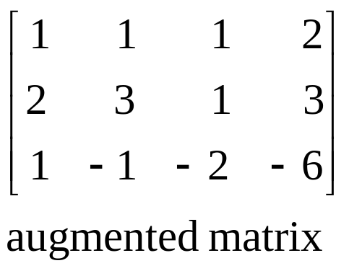
Relations between system of linear equations and matrices
matrix of coefficients and augmented matrix
Observe that the matrix of coefficients is a submatrix of the augmented matrix. The augmented matrix completely describes the system.
Ch1_<number>
Ch1_<number>
Notes:
We use matrices to describe systems of linear equations. There are two important matrices associated
with every system of linear equations. The coefficients of the variables form a matrix called
the matrix of coefficients of the system. The coefficients, together with the constant terms, form a matrix called the augmented matrix of the system.

Slide 25
Relations between system of linear equations and matrices
Transformations called elementary transformations can be used to change a system of linear equations into another system of linear equations that has the same solution.
These transformations are used to solve systems of linear equations by eliminating variables.
In practice it is simpler to work in terms of matrices using analogous transformations called elementary row operations.
Ch1_<number>
Ch1_<number>
Notes:
We use matrices to describe systems of linear equations. There are two important matrices associated
with every system of linear equations. The coefficients of the variables form a matrix called
the matrix of coefficients of the system. The coefficients, together with the constant terms, form a matrix called the augmented matrix of the system.

Slide 26
Elementary Row Operations of Matrices
These transformations are as follows:
Elementary Transformation
Interchange two equations.
Multiply both sides of an equation by a nonzero constant.
Add a multiple of one equation to another equation.
Elementary Row Operation
Interchange two rows of a matrix.
Multiply the elements of a row by a nonzero constant.
Add a multiple of the elements of one row to the corresponding elements of another row.
Ch1_<number>
Ch1_<number>

Slide 27
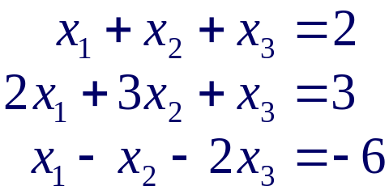
Example 1
Solving the following system of linear equation.
Ch1_<number>
Ch1_<number>

Slide 28
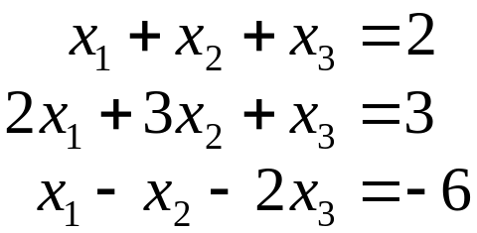
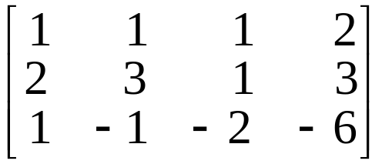
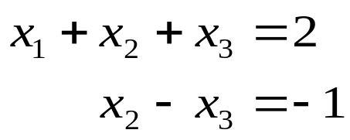
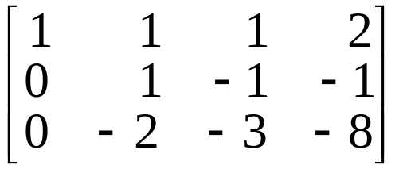

Example 1
Solving the following system of linear equation.
≈ row equivalent
Solution
Equation Method
Initial system:
Analogous Matrix Method
Augmented matrix:
Eq2+(–2)Eq1
Eq3+(–1)Eq1
≈
R2+(–2)R1
R3+(–1)R1
Ch1_<number>
Ch1_<number>

Slide 29
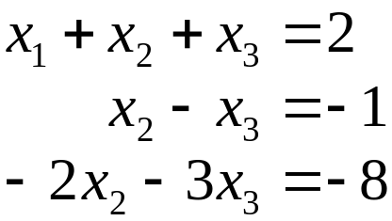
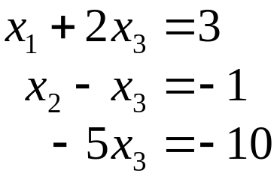
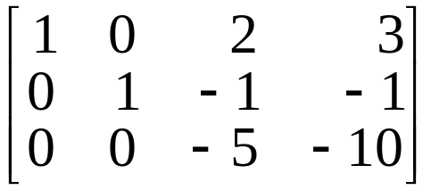
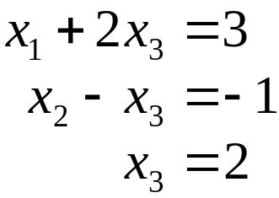
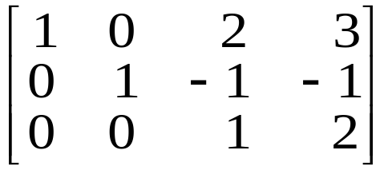
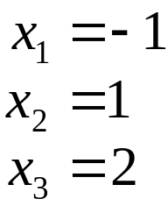
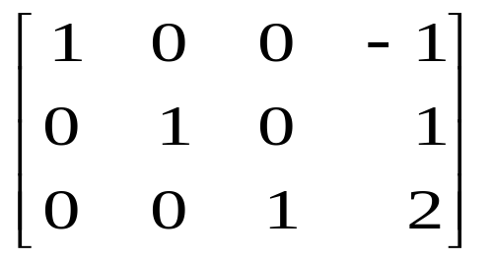

Eq1+(–1)Eq2
Eq3+(2)Eq2
≈
R1+(–1)R2
(–1/5)Eq3
R3+(2)R2
Eq1+(–2)Eq3
≈
Eq2+Eq3
(–1/5)R3
≈
R1+(–2)R3
R2+R3
The solution is
The solution is
Ch1_<number>
Ch1_<number>

Slide 30
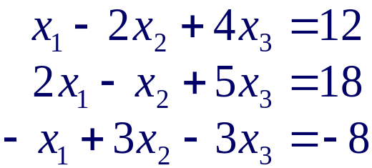
Example 2
Solving the following system of linear equation.
Solution
Ch1_<number>
Ch1_<number>

Slide 31
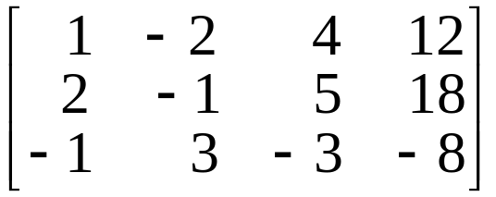
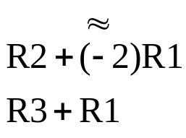
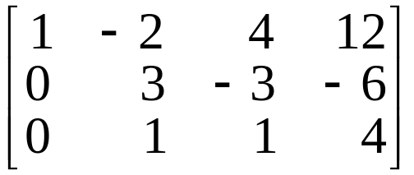
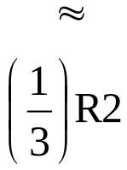
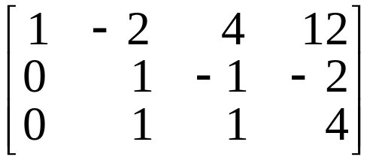
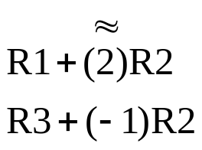
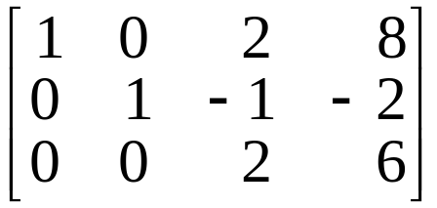
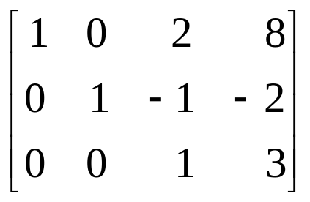
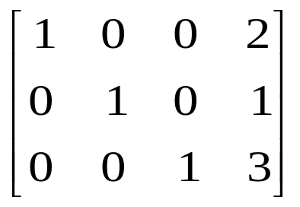
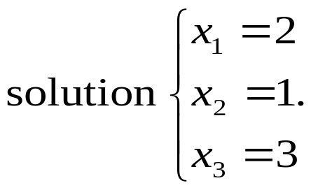
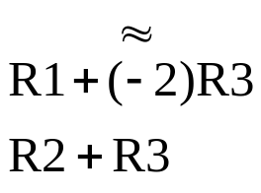
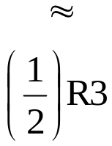
Example 2
Solving the following system of linear equation.
Solution
Ch1_<number>
Ch1_<number>

Slide 32
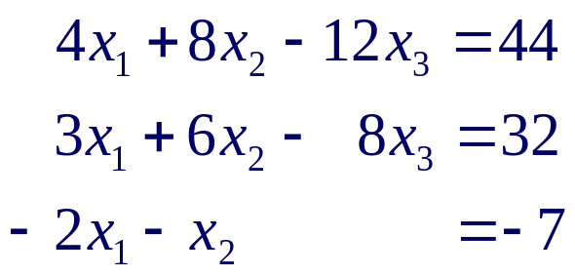
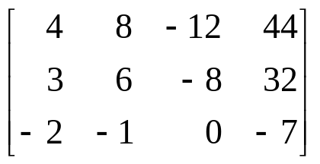
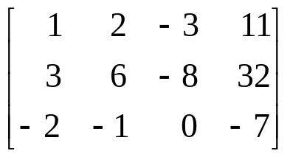
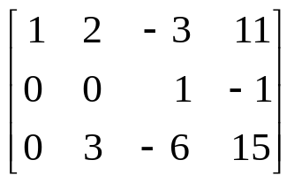










Example 3
Solve the system
Solution
Ch1_<number>
Ch1_<number>

Slide 33




Summary
Use row operations to [A: B] :
A
B
i.e.,
Def. [I_{n} : X] is called the reduced echelon form of [A : B].
Note. 1. If A is the matrix of coefficients of a system of n equations in n variables that has a unique solution,
then A is row equivalent to I_{n} (A ≈ I_{n}).
2. If A ≈ I_{n}, then the system has unique solution.
Ch1_<number>
Ch1_<number>

Slide 34


Example 4 Many Systems
Solving the following three systems of linear equation, all of which have the same matrix of coefficients.
Solution
Ch1_<number>
Ch1_<number>

Slide 35







Example 4 Many Systems
Solving the following three systems of linear equation, all of which have the same matrix of coefficients.
Solution
≈
R2+(–2)R1
R3+R1
The solutions to
the three systems are
Ch1_<number>
Ch1_<number>

Slide 36
Homework
Exercise 1.1: (page 12)
1, 5, 11, 13
Ch1_<number>
Ch1_<number>

Slide 37
1.2 Gauss-Jordan Elimination
More generalization of Gauss-Jordan Elimination
Definition
A matrix is in reduced echelon form if
Any rows consisting entirely of zeros are grouped at the bottom of the matrix.
The first nonzero element of each other row is 1. This element is called a leading 1.
The leading 1 of each row after the first is positioned to the right of the leading 1 of the previous row.
All other elements in a column that contains a leading 1 are zero.
Ch1_<number>
Ch1_<number>

Slide 38

Ch1_<number>
Ch1_<number>

Slide 39

Ch1_<number>
Ch1_<number>

Slide 40

Examples for reduced echelon form
(?)
(?)
(?)
(?)
Elementary row operations reduced echelon form
The reduced echelon form of a matrix is unique.
Ch1_<number>
Ch1_<number>

Slide 41
Examples for reduced echelon form
()
()
()
()
There are usually many sequences of row operations that can be used to transform a given matrix to reduced echelon form-they all, however, lead to the same reduced echelon form.
We say that the reduced echelon form of a matrix is unique.
Ch1_<number>
Ch1_<number>

Slide 42
Gauss-Jordan Elimination
System of linear equations
⇒ augmented matrix
⇒ reduced echelon form
⇒ solution
Ch1_<number>
Ch1_<number>

Slide 43

Example 1
Use the method of Gauss-Jordan elimination to find reduced echelon form of the following matrix.
Solution
Ch1_<number>
Ch1_<number>

Slide 44






Example 1
Use the method of Gauss-Jordan elimination to find reduced echelon form of the following matrix.
Solution
pivot (leading 1)
pivot
Ch1_<number>
The matrix is the reduced echelon form of the given matrix.
Ch1_<number>

Slide 45






Example 2
Solve, if possible, the system of equations
Solution
The general solution to the system is
Ch1_<number>
Ch1_<number>

Slide 46







Example 3
Solve the system of equations
⇒ many sol.
Solution
Ch1_<number>
Ch1_<number>

Slide 47







Example 4
Solve the system of equations
Solution
Ch1_<number>
Ch1_<number>

Slide 48







Example 5
This example illustrates a system that has no solution. Let us try to solve the system
Solution
0x₁+0x₂+0x₃=1
The system has no solution.
Ch1_<number>
Ch1_<number>

Slide 49


Homogeneous System of linear Equations
Definition
A system of linear equations is said to be homogeneous if all the constant terms are zeros.
Example:
Observe that is a solution.
Theorem 1.1
A system of homogeneous linear equations in n variables always has the solution x₁ = 0, x₂ = 0. …, x_{n} = 0. This solution is called the trivial solution.
Ch1_<number>
Ch1_<number>

Slide 50


Homogeneous System of linear Equations
Note. Non trivial solution
Example:
The system has other nontrivial solutions.
Theorem 1.2
A system of homogeneous linear equations that has more variables than equations has many solutions.
Ch1_<number>
Ch1_<number>

Slide 51
Homework
Exercise set 1.2: (page 21)
2, 5, 6, 7, 8, 14
Ch1_<number>
Ch1_<number>

Slide 52
1.3 Gaussian Elimination
Definition
A matrix is in echelon form if
Any rows consisting entirely of zeros are grouped at the bottom of the matrix.
The first nonzero element of each row is 1. This element is called a leading 1.
The leading 1 of each row after the first is positioned to the right of the leading 1 of the previous row.
(This implies that all the elements below a leading 1 are zero.)
Ch1_<number>

Slide 53





Example 6
Solving the following system of linear equations using the method of Gaussian elimination.
Solution
Starting with the augmented matrix, create zeros below the pivot in the first column.
At this stage, we create a zero only below the pivot.
We have arrived at the echelon form.
Echelon form
Ch1_<number>

Slide 54



The corresponding system of equation is
We get
Substituting x₄ = 2 and x₃ = −5 into the first equation,
Let x₂ = r. The system has many solutions. The solutions are
Ch1_<number>

Slide 55

Example 7
Solving the following system of linear equations using the method of Gaussian elimination, performing back substitution using matrices.
Solution
We arrive at the echelon form as in the previous example.
Echelon form
This marks the end of the forward elimination of variables from equations. We now commence the back substitution using matrices.
Ch1_<number>

Slide 56



3
2
This matrix is the reduced echelon form of the original augmented matrix. The corresponding system of equations is
Let x₂ = r. We get same solution as previously,
Ch1_<number>

